Slide 1
CSC/DSCC 574 Continuous Algorithms for Optimization and Sampling Spring 2024
Jiaming Liang
Goergen Institute for Data Science/Department of Computer Science
University of Rochester
January 18, 2024

Slide 2
Course Information
Time: Tuesday & Thursday, 11:05 – 12:20 pm
Location: Meliora Hall 209
Instructor: Jiaming Liang
Blackboard
Website: https://jiaming-liang.github.io/CONTALG.html
Office hour: by appointment

Slide 3
Instructor – Jiaming Liang
Assistant professor in Data Science and Computer Science
Wegmans Hall 2403
jiaming.liang@rochester.edu
Ph.D. in Operations Research, Georgia Tech
Postdoc in Computer Science, Yale
Research interests: nonsmooth optimization, stochastic optimization, sampling algorithms

Slide 4
Grading
Project proposal 20% (Feb. 27)
Midterm presentation 25% (Mar. 19 & 21), online
Final presentation 25% (Apr. 25 & 30)
Final report 30% (May 2)

Slide 5
Project
An in-depth exploration of a topic in continuous optimization and/or sampling
A survey of a topic covered in class or choose your own
Implementation of algorithms applied on an interesting application
New ideas on research, bring your own research project + techniques from this course

Slide 6
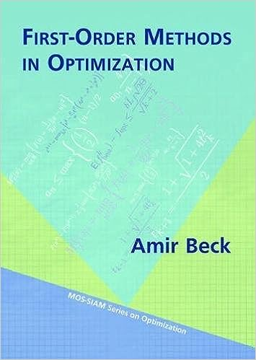
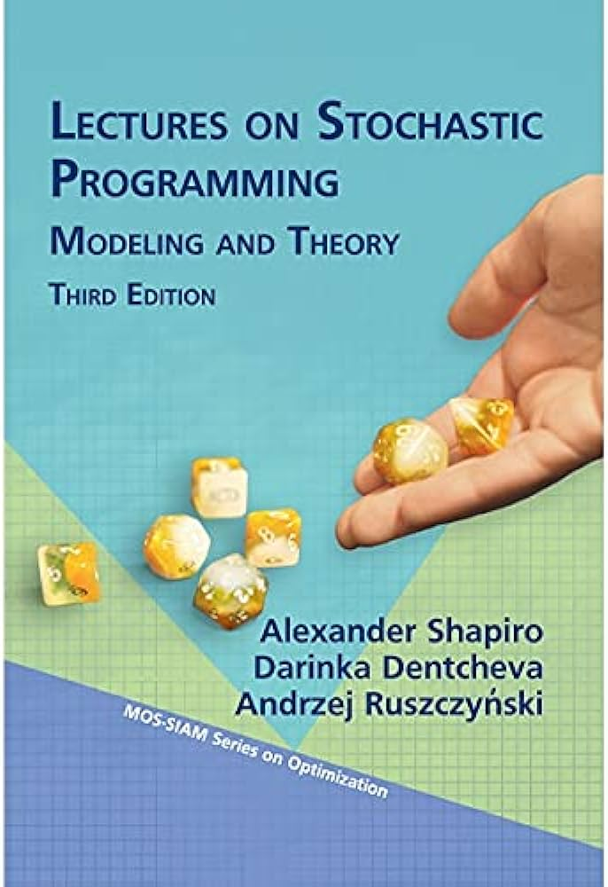
Textbooks
Amir Beck. First-order methods in optimization. SIAM, 2017.
Alexander Shapiro, Darinka Dentcheva, and Andrzej Ruszczynski. Lectures on Stochastic Programming: Modeling and Theory. SIAM, 2021.

Slide 7
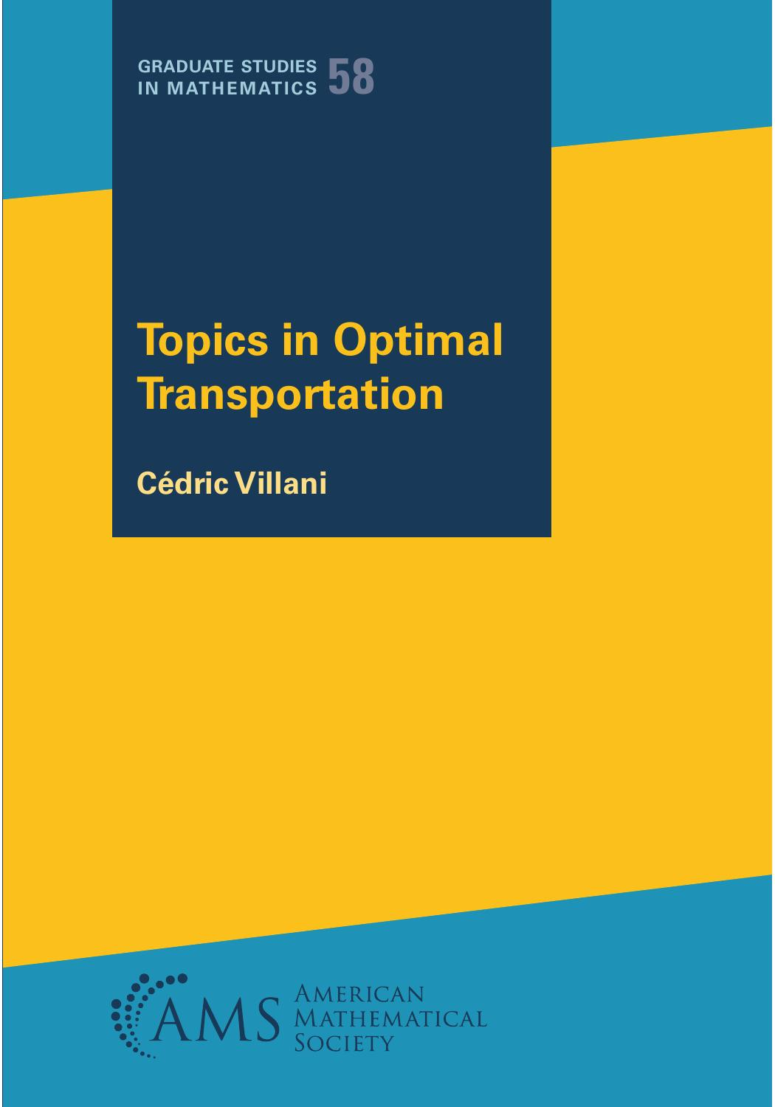
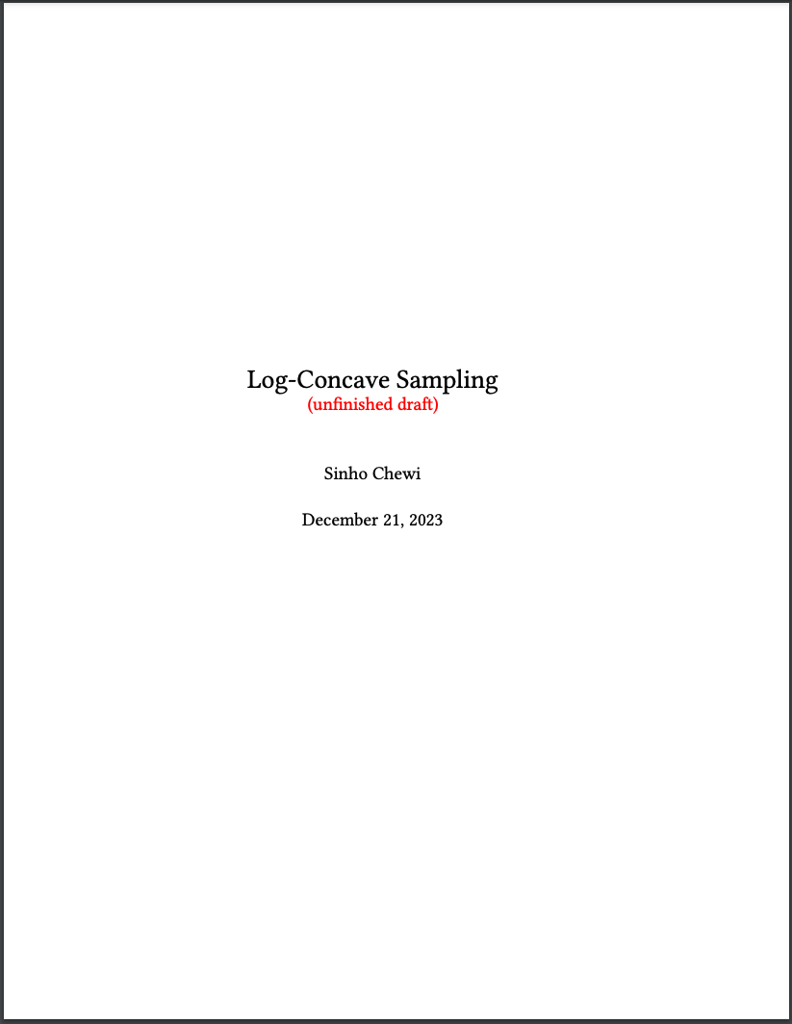
Textbooks
Cédric Villani. Topics in Optimal Transportation. American Mathematical Society, 2021.
Sinho Chewi. Log-Concave Sampling. Draft, 2023.

Slide 8
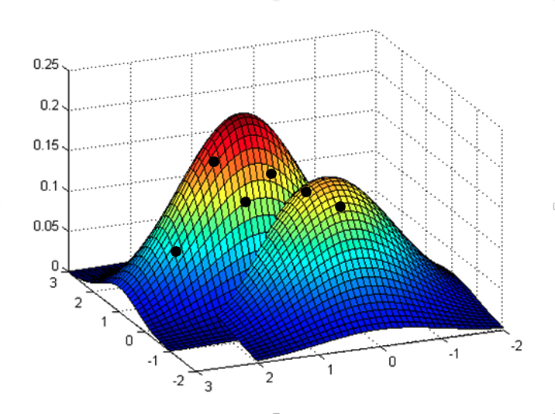
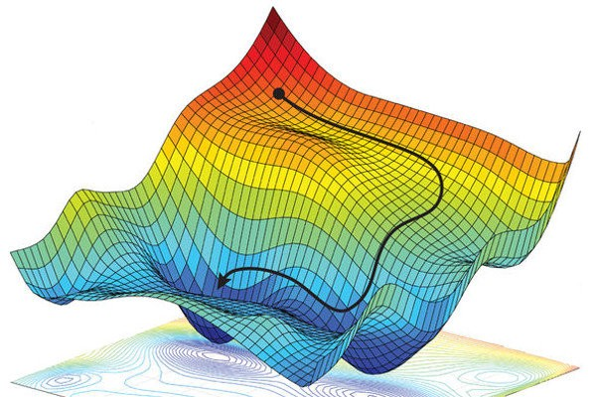
Objective
Develop a combined perspective that leads to simultaneous progress on both optimization and sampling by leveraging the connections between the two.

Slide 9

Sampling
Sampling plays a pivotal role in machine learning (GANs, VAE, diffusion model, …)
A central paradigm in many subjects: Bayesian statistics, statistical physics, differential privacy, online algorithms, imaging science, …

Slide 10
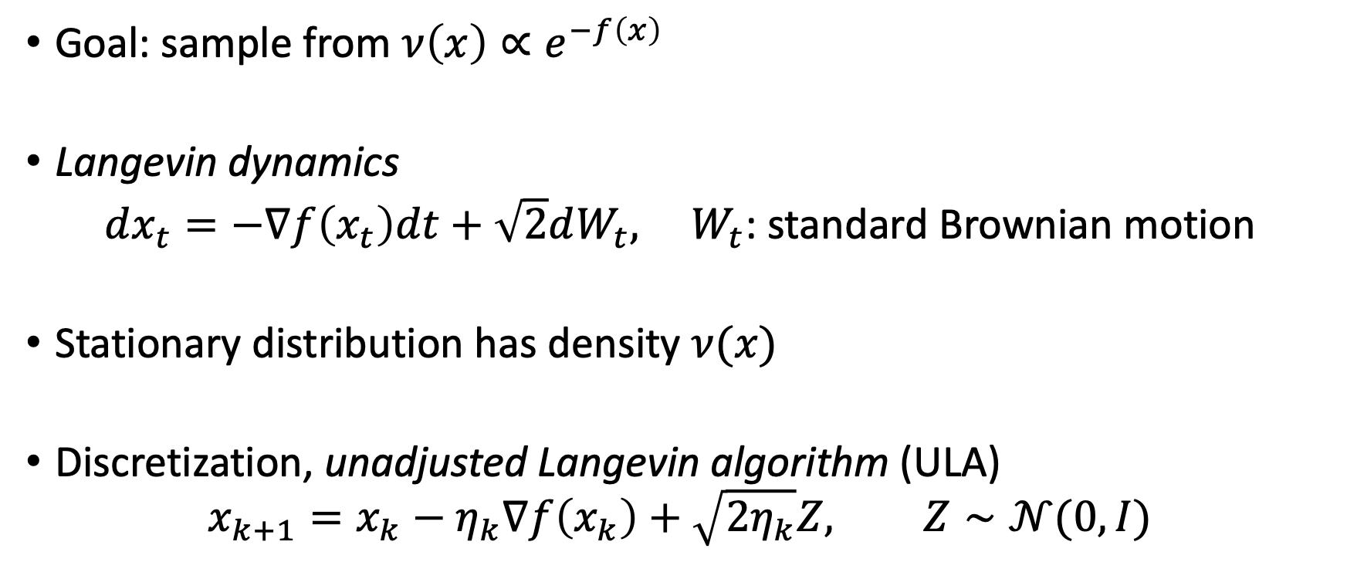
Langevin dynamics
Goal: sample from $ν\left(x\right)∝e^{−f\left(x\right)}$
Langevin dynamics
$dx_{t}=−∇f\left(x_{t}\right)dt+\sqrt{2}dW_{t}, W_{t}$: standard Brownian motion
Stationary distribution has density $ν(x)$
Discretization, unadjusted Langevin algorithm (ULA)
$$x_{k+1}=x_{k}−η_{k}∇f\left(x_{k}\right)+\sqrt{2η_{k}}Z, Z∼𝒩(0,I)$$

Slide 11
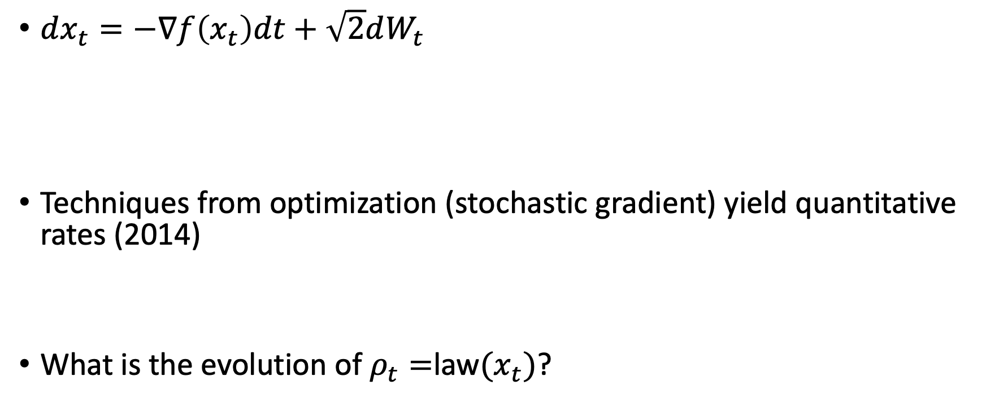
Stochastic optimization
$dx_{t}=−∇f\left(x_{t}\right)dt+\sqrt{2}dW_{t}$
Techniques from optimization (stochastic gradient) yield quantitative rates (2014)
What is the evolution of $ρ_{t}=$law$(x_{t})$?
Gradient flow
Stochastic term

Slide 12
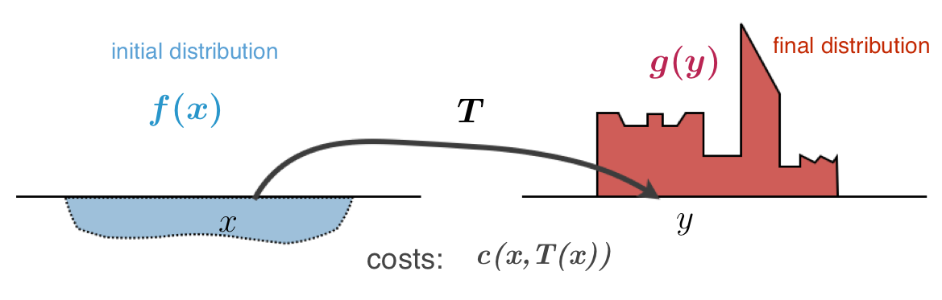
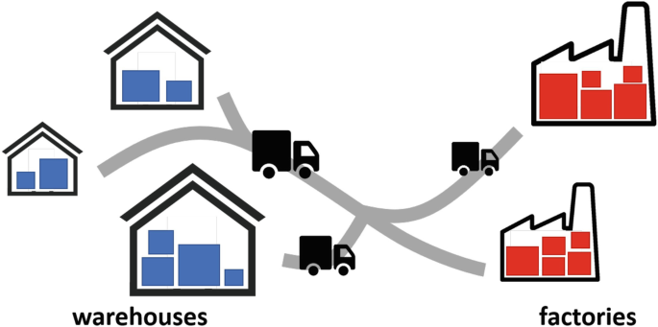
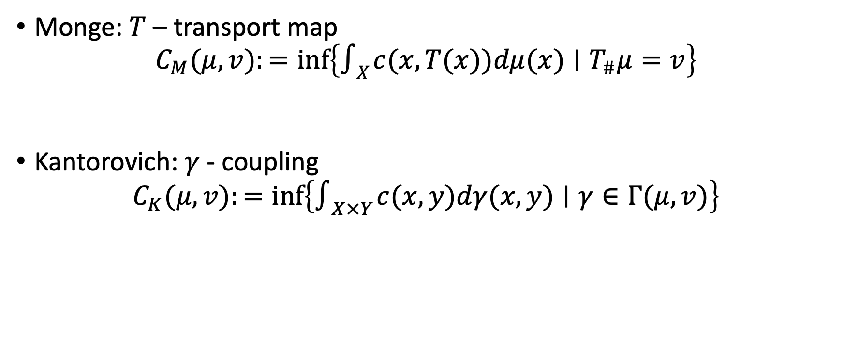
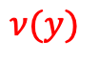
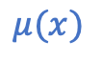
Optimal transport
$$ν(y)$$
$$μ(x)$$
Monge: $T$ – transport map
$$C_{M}(μ,v):=inf\left\{∫_{X} c(x,T(x))dμ(x)∣T_{\#}μ=v\right\}$$
Kantorovich: $γ$ - coupling
$$C_{K}(μ,v):=inf\left\{∫_{X×Y} c(x,y)dγ(x,y)∣γ∈Γ(μ,v)\right\}$$
Notes:
Take a map $T:X→Y$ and a probability measure $μ∈𝒫(X)$. We define the image measure (or push-forward measure) $T_{\#}μ∈𝒫(Y)$ as
$\left(T_{\#}μ\right)(A):=μ\left(T^{−1}(A)\right)$ for any $A∈ℬ(Y)$
Let $T:X→Y,μ∈𝒫(X)$, and $v∈𝒫(Y)$. Then
$$v=T_{\#}μ$$
if and only if, for any $φ:Y→ℝ$ Borel and bounded, we have
$$\int_{Y}{ }φ(y)dv(y)=\int_{X}{ }φ(T(x))dμ(x).$$

Slide 13
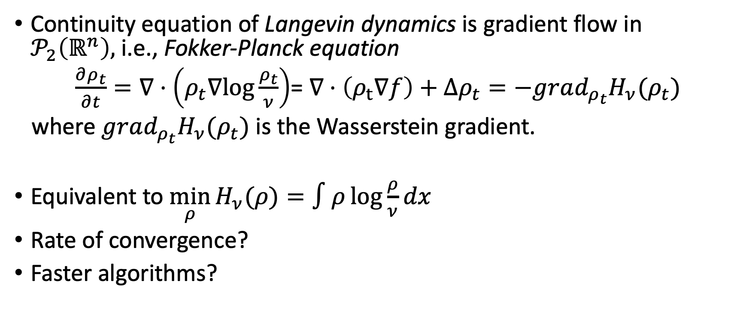
Wasserstein gradient flow
Continuity equation of Langevin dynamics is gradient flow in $𝒫_{2}\left(ℝ^{n}\right),$i.e., Fokker-Planck equation
$\frac{∂ρ_{t}}{∂t}=∇⋅\left(ρ_{t}∇log\frac{ρ_{t}}{ν}\right)$= $∇⋅\left(ρ_{t}∇f\right)+Δρ_{t}=−grad_{ρ_{t}}H_{ν}(ρ_{t})$
where $grad_{ρ_{t}}H_{ν}(ρ_{t})$ is the Wasserstein gradient.
Equivalent to $\min_{ρ}{H_{ν}(ρ)}=∫ρ\log{\frac{ρ}{ν}dx}$
Rate of convergence?
Faster algorithms?
Notes:
Interpretation $ρ_{t+η}={\left(I_{d}−η∇f−η∇\log{ρ_{t}}\right)}_{\#}ρ_{t}$
Langevin dynamics in space corresponds to the gradient flow of the relative entropy functional in the space of measures with the Wasserstein metric. This is why running the Langevin dynamics is useful for sampling: It is the steepest descent flow that attracts any initial distribution to the stationary target measure.

Slide 14
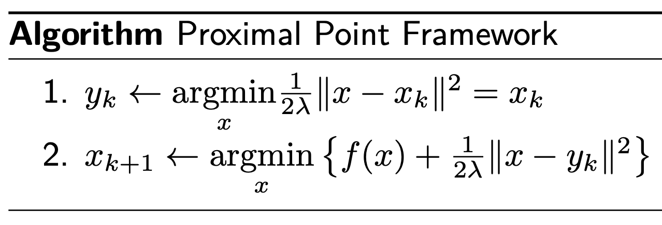
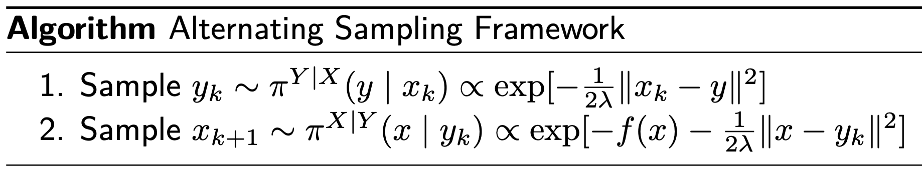
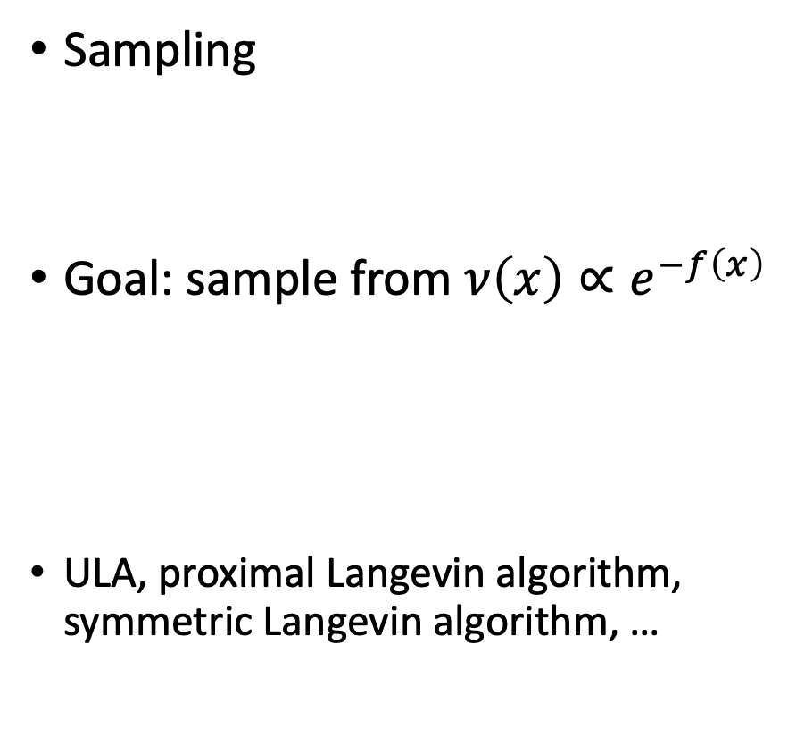
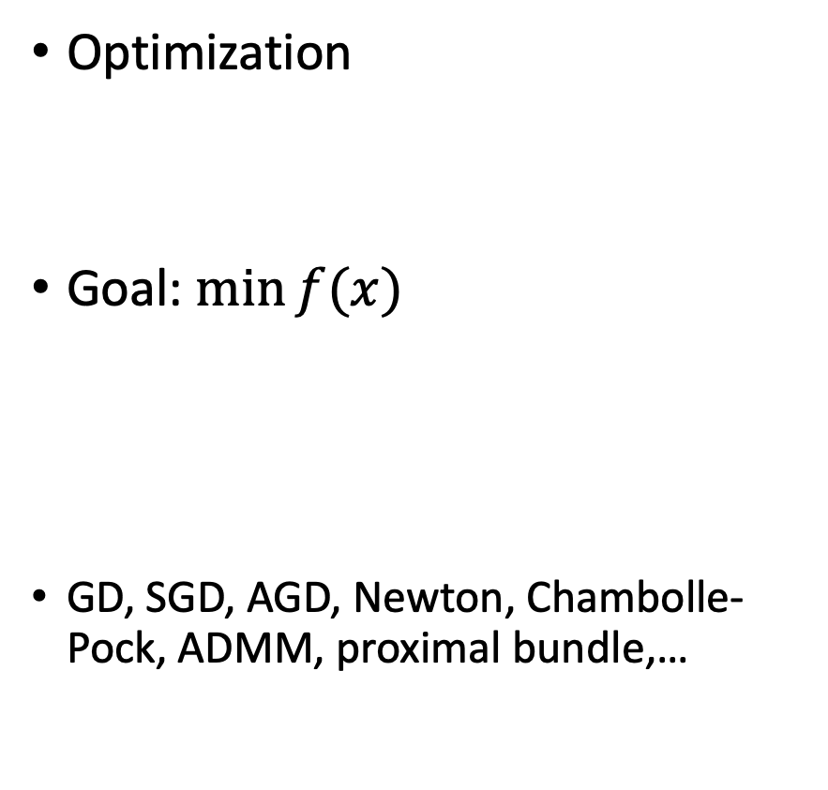
Proximal algorithms
Optimization
Goal: $\min{f(x)}$
GD, SGD, AGD, Newton, Chambolle-Pock, ADMM, proximal bundle,…
Sampling
Goal: sample from $ν\left(x\right)∝e^{−f\left(x\right)}$
ULA, proximal Langevin algorithm, symmetric Langevin algorithm, …

Slide 15
Topics (tentative)
Continuous optimization
Subgradient method
Mirror descent
Proximal gradient method
Frank-Wolfe method
Stochastic optimization
Stochastic approximation and sample average approximation
﻿Dynamic programming and reinforcement learning
Risk averse optimization
﻿Distributionally robust optimization
﻿Statistical efficiency

Slide 16
Optimal transport
Monge-Kantorovich problem and Kantorovich duality
Wasserstein space and Otto’s calculus
Transport inequalities
Entropic regularization and gradient flows
Sinkhorn algorithm
Economics applications
Sampling
Rejection sampling and Metropolis–Hastings filter
﻿Stochastic calculus
﻿Langevin Monte Carlo
﻿Proximal sampling
Diffusion generative models
Differential privacy

Slide 17
Optimization basics

Slide 18
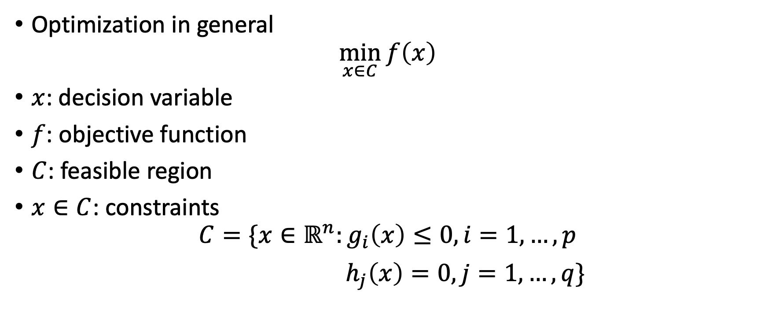
Optimization program
Optimization in general
$$\min_{x∈C}{f\left(x\right)}$$
$x$: decision variable
$f$: objective function
$C$: feasible region
$x∈C$: constraints
$$C=\{x∈ℝ^{n}:g_{i}\left(x\right)≤0, i=1,…,p$$
$h_{j}\left(x\right)=0, j=1,…, q\}$

Slide 19
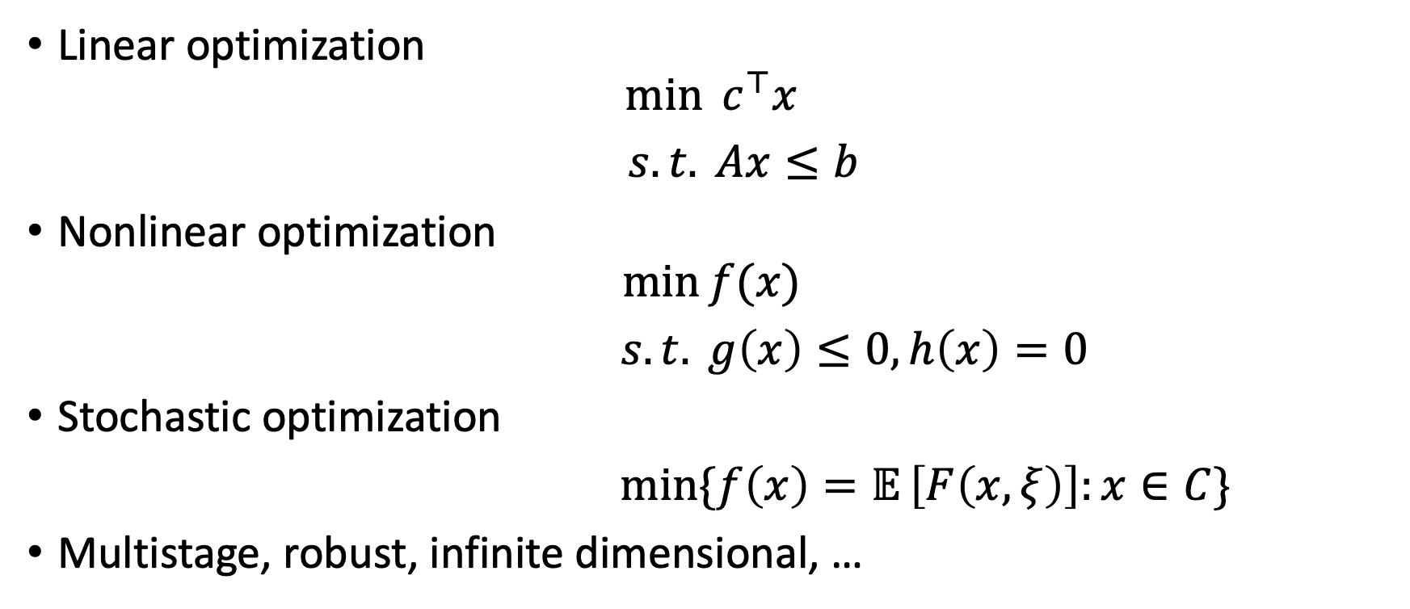
Types of optimization problems
Linear optimization
$$\min{{ c}^{⊤}x}$$
$s.t. Ax≤b$
Nonlinear optimization
$$\min{f(x)}$$
$s.t. g\left(x\right)≤0, h\left(x\right)=0$
Stochastic optimization
$\min{\{f\left(x\right)=𝔼}\left[F\left(x,ξ\right)\right]:x∈C\}$
Multistage, robust, infinite dimensional, …

Slide 20
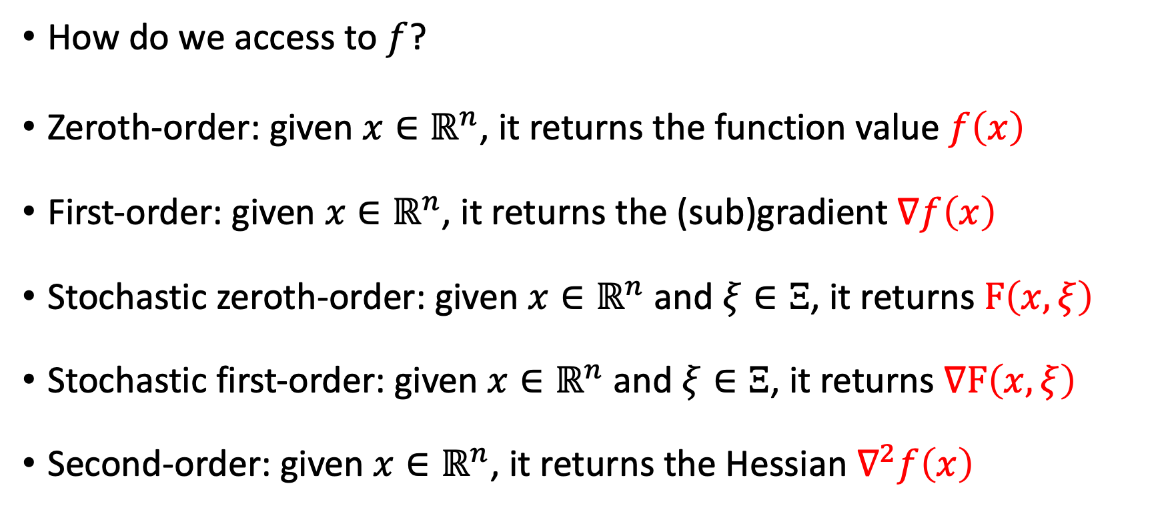
Black-box oracles
This course mainly focuses on first-order methods using zeroth and first-order oracles. We will briefly discuss second and higher-order methods as well.
How do we access to $f$?
Zeroth-order: given $x∈ℝ^{n}$, it returns the function value $f\left(x\right)$
First-order: given $x∈ℝ^{n}$, it returns the (sub)gradient $∇f\left(x\right)$
Stochastic zeroth-order: given $x∈ℝ^{n}$ and $ξ∈Ξ$, it returns $F\left(x,ξ\right)$
Stochastic first-order: given $x∈ℝ^{n}$ and $ξ∈Ξ$, it returns $∇F\left(x,ξ\right)$
Second-order: given $x∈ℝ^{n}$, it returns the Hessian $∇^{2}f\left(x\right)$

Slide 21
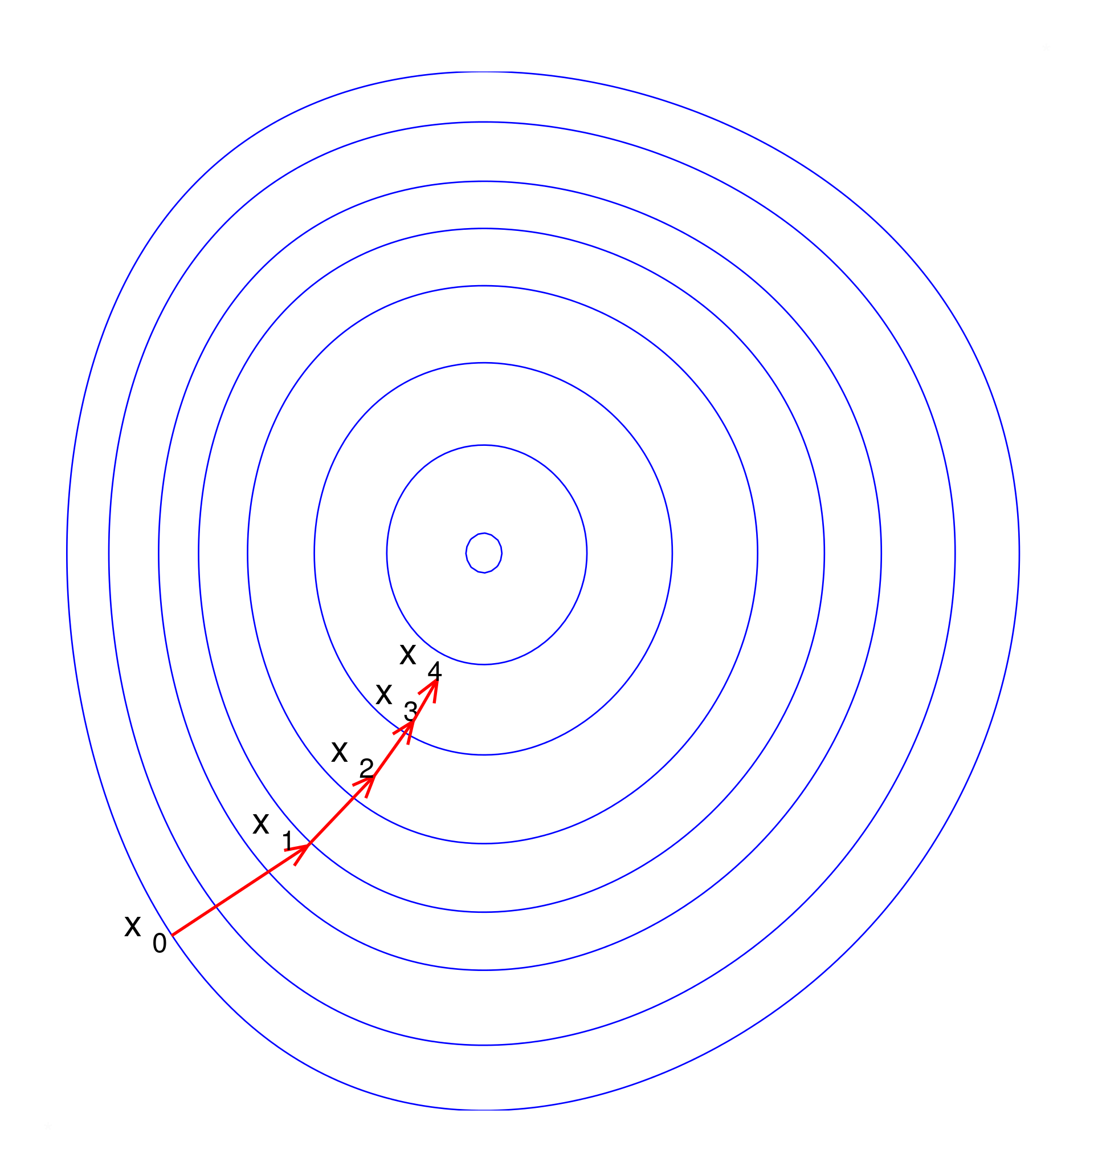
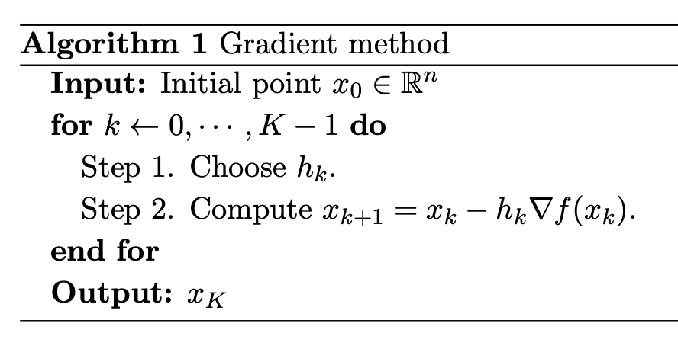
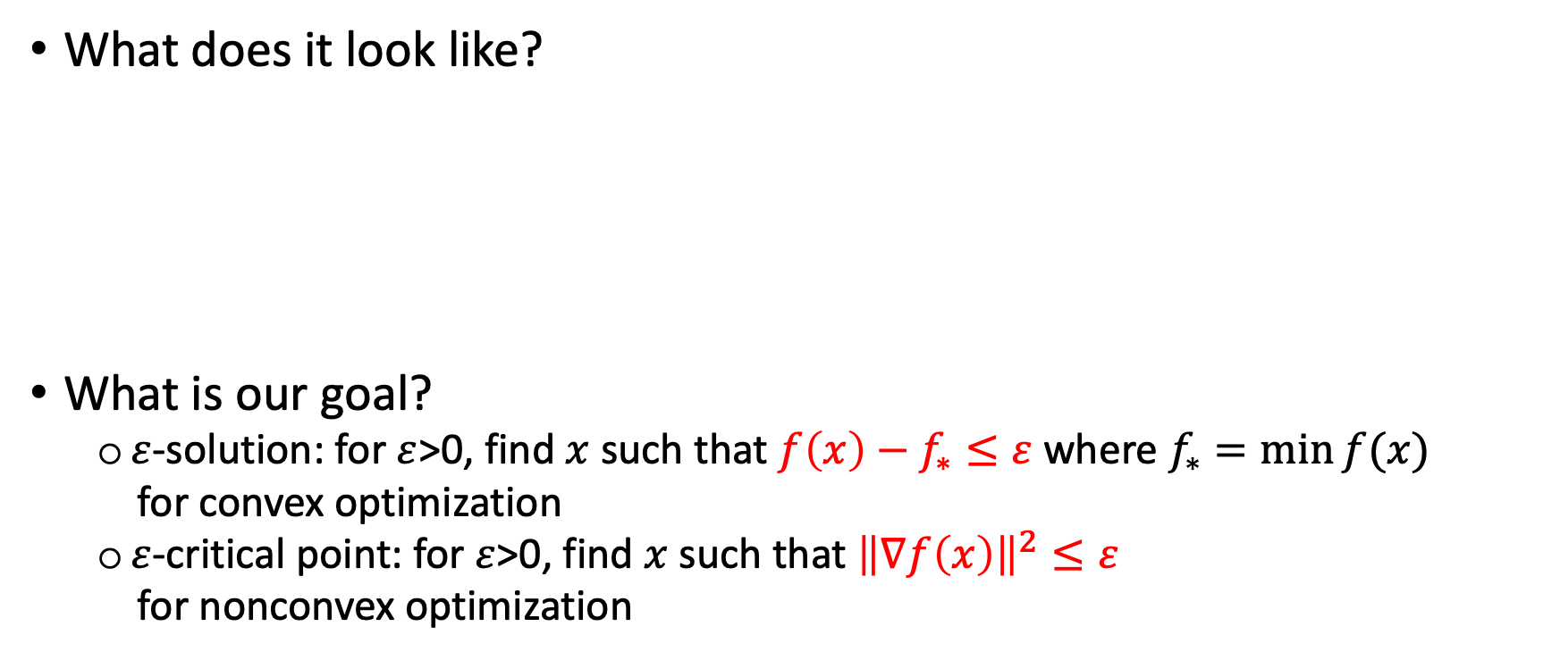
Optimization algorithms
What does it look like?
What is our goal?
$ε$-solution: for $ε$>0, find $x$ such that $f\left(x\right)−f_{∗}≤ε$ where $f_{∗}=\min{f(x)}$
for convex optimization
$ε$-critical point: for $ε$>0, find $x$ such that ${\left\|∇f\left(x\right)\right\|}^{2}≤ε$
for nonconvex optimization

Slide 22
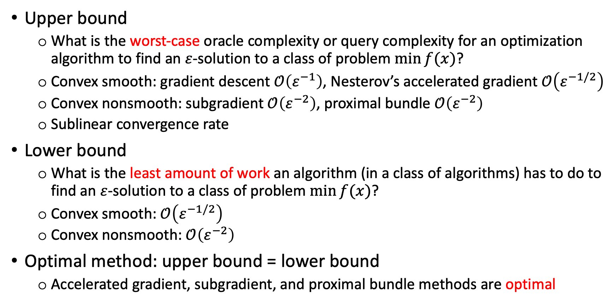
Complexity analysis
Upper bound
What is the worst-case oracle complexity or query complexity for an optimization algorithm to find an $ε$-solution to a class of problem $\min{f(x)}$?
Convex smooth: gradient descent $𝒪\left(ε^{−1}\right)$, Nesterov’s accelerated gradient $𝒪\left(ε^{−1/2}\right)$
Convex nonsmooth: subgradient $𝒪\left(ε^{−2}\right)$, proximal bundle $𝒪\left(ε^{−2}\right)$
Sublinear convergence rate
Lower bound
What is the least amount of work an algorithm (in a class of algorithms) has to do to find an $ε$-solution to a class of problem $\min{f(x)}$?
Convex smooth: $𝒪\left(ε^{−1/2}\right)$
Convex nonsmooth: $𝒪\left(ε^{−2}\right)$
Optimal method: upper bound = lower bound
Accelerated gradient, subgradient, and proximal bundle methods are optimal

Slide 23
Thank you!

